Slide 1

Graphical User Interface
For testing state-of-the-art models
25 – 08 - 2023

Slide 2
GUI
A PySide6 (QT) Application
Cross-Platform and User-Friendly GUI
Testing and Comparing SOTA Models

Slide 3
PySide6
is a Python library that connects Python code with the Qt framework, a robust C++ platform for creating cross-platform applications with GUIs and advanced features.
1.Cross-Platform
2.GUI Development
3.Rich Functionality

Slide 4
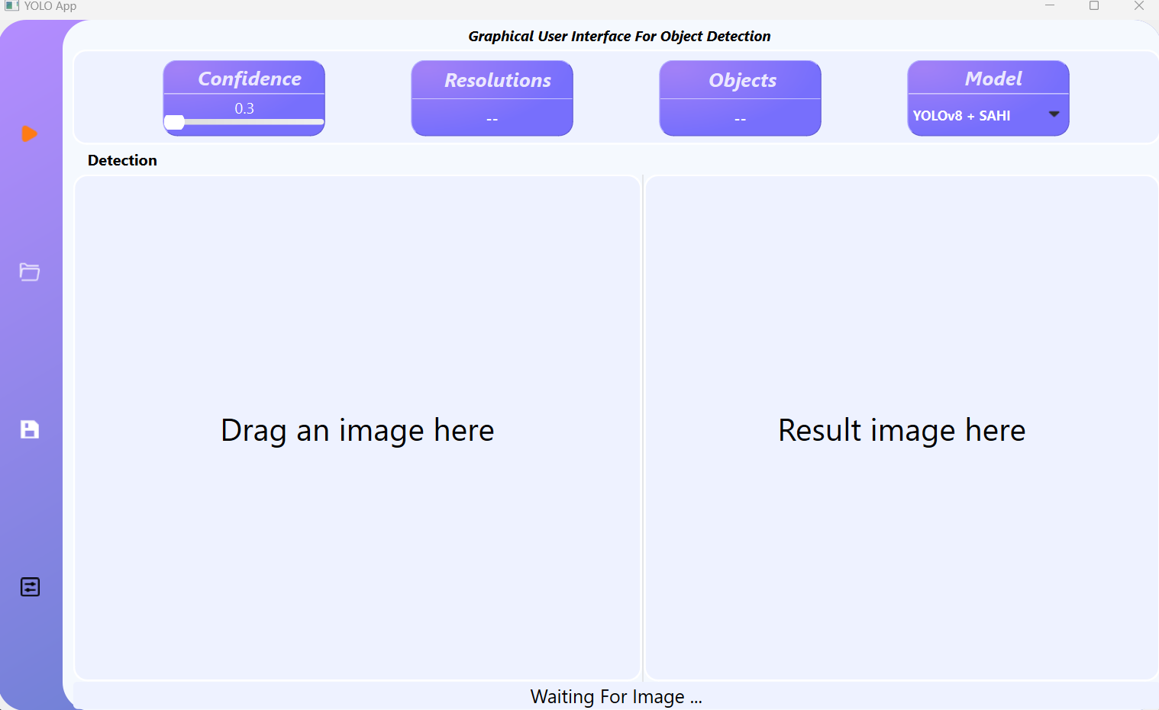
Overview Of The GUI

Slide 5
Overview Of The GUI
TOP MENU BUTTONS:
A slider to select the value of the confidence threshold
A Resolution box to display the height and width of the image once inserted
Objects box to display the number of objects detected after Inference
A drop down menu to select the model

Slide 6

Models:
YOLOv8L
YOLOv8L + Slicing Aided Hyper Inference(SAHI)
YOLO-NAS

Slide 7
Overview Of The GUI
Left Menu Buttons :
A start Button to start inference
A Files Button to select the image from your machine
A save Button to save the result image after inference
A Settings Button to display the results of the inference once it’s done

Slide 8
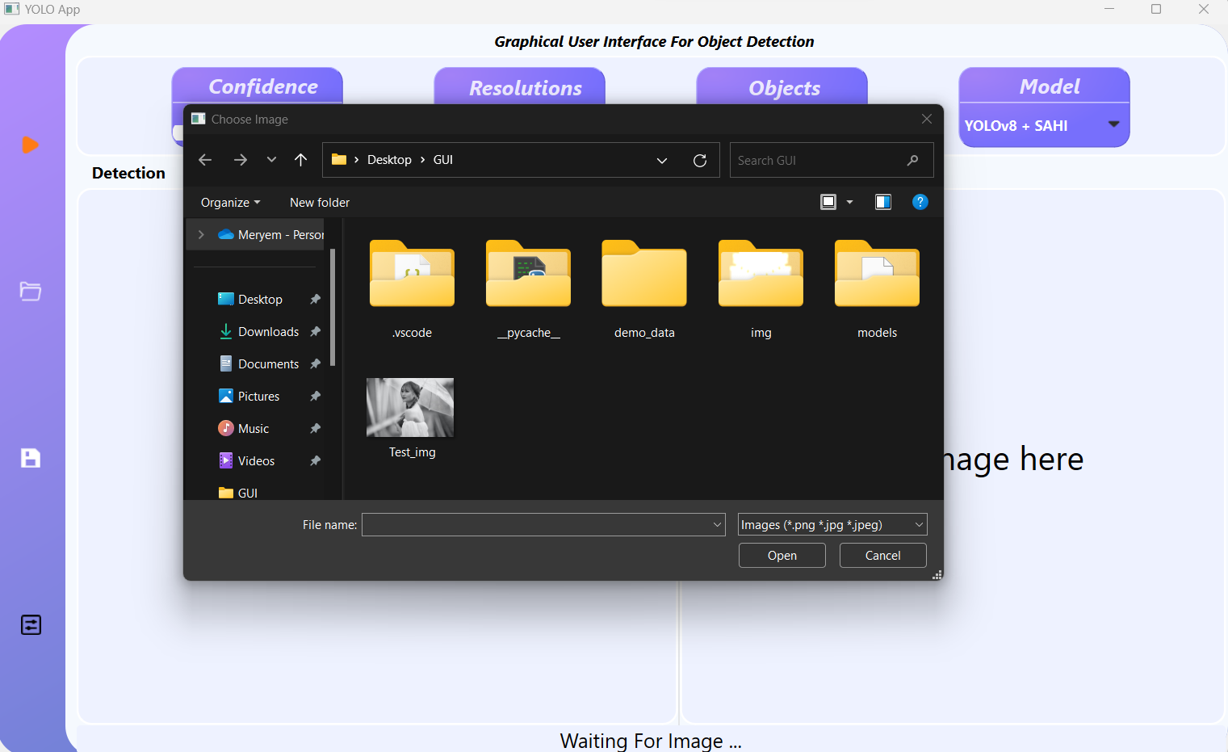
Select the image of drag and drop it

Slide 9
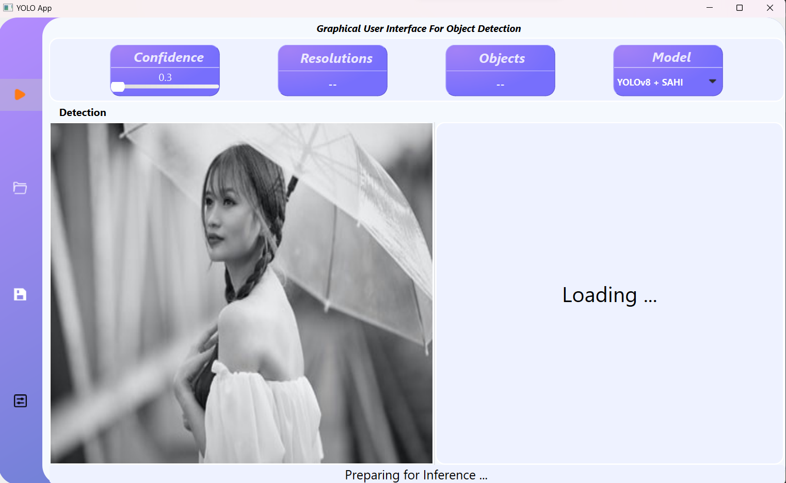
Start The inference

Slide 10
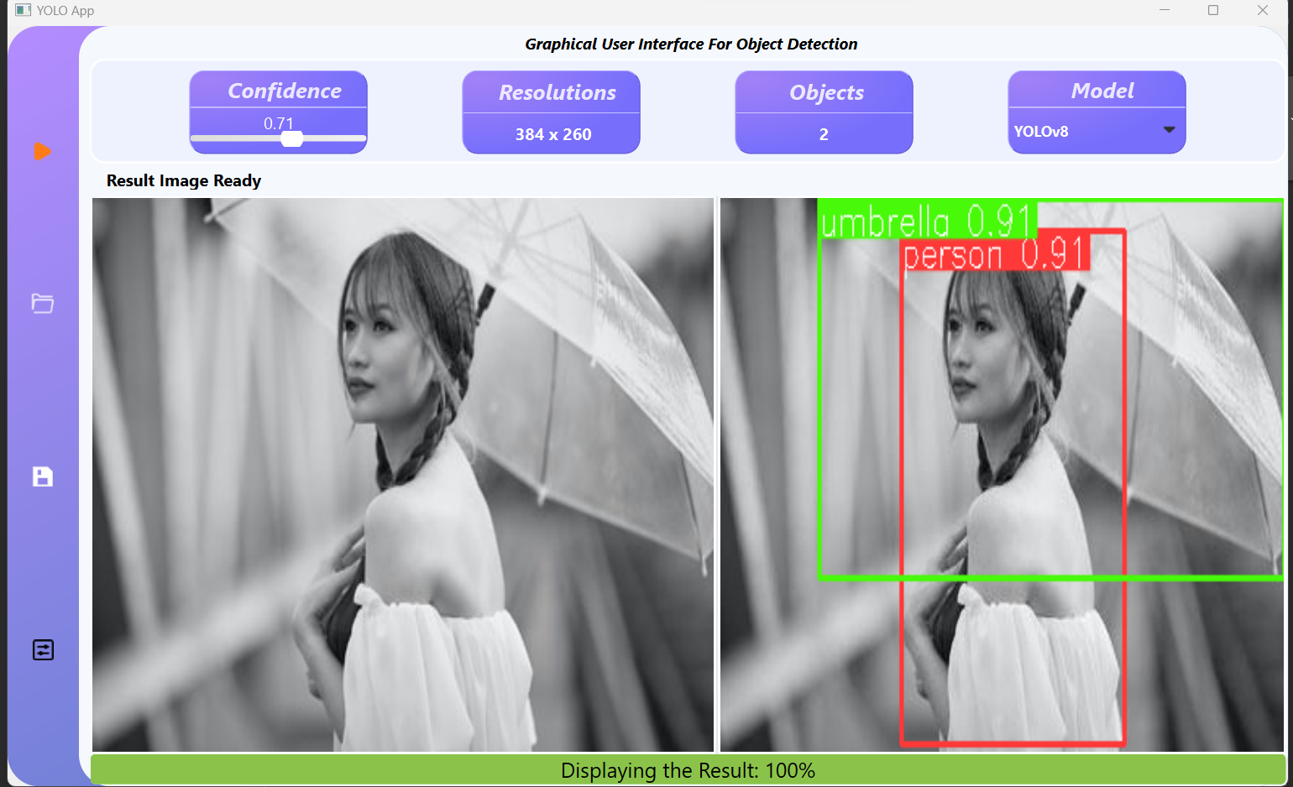
Wait Until It’s Done
Progress Bar

Slide 11
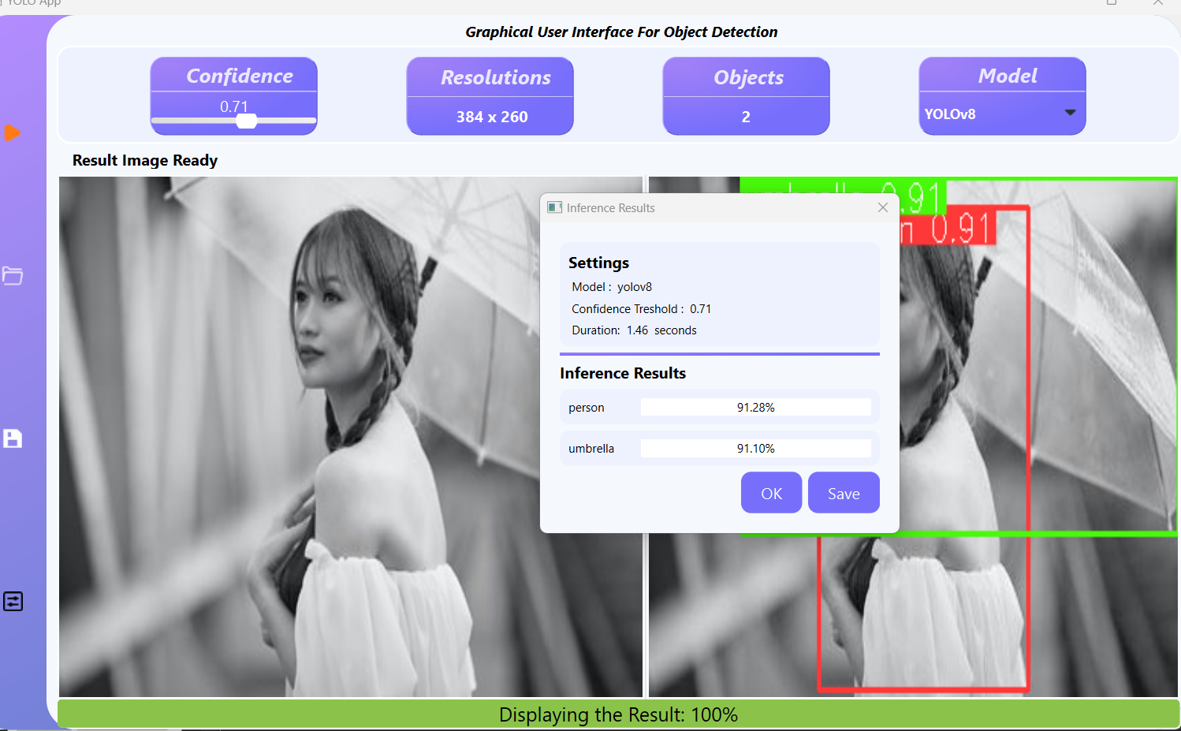
A pop-up Window that displays the results:

Slide 12
You can save the results or just selecting “OK”

Slide 13
Conclusion
I hope this presentation has helped you gain a comprehensive understanding of the core Features of the GUI .

